Slide 1
Jump Statements/ branching statements
Jump Statement makes the control jump to another section of the program unconditionally when encountered.
Used to terminate the loop or switch-case instantly.
Used to escape the execution of a section of the program.
break
Continue
goto
Notes:
We will see return in later lesson

Slide 2
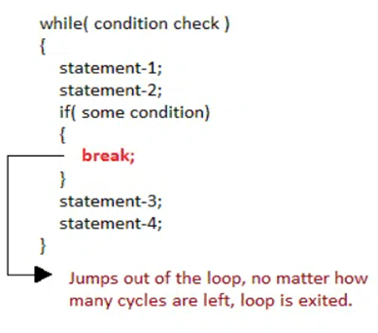
Control with break and continue
A break statement is used to terminate the execution of the rest of the block where it is present and takes the control out of the block to the next statement.
To terminate the loop or switch block
Syntax:
break;
Notes:
As soon as the break statement is encountered from within a loop, the loop iterations stops there and control returns from the loop immediately to the first statement after the loop.

Slide 3
Write a C program to break for loop when for 5th iteration of loop statement.
output:
0 1 2 3 4 5 came outside of loop i = 5
Notes:
As soon as the break statement is encountered from within a loop, the loop iterations stops there and control returns from the loop immediately to the first statement after the loop.

Slide 4
Write a C program to break for loop when for 5th iteration of loop statement.
#include<stdio.h>
#include<stdlib.h>
void main ()
{
int i;
for(i = 0; i<10; i++)
{
printf("%d ",i);
if(i == 5)
break;
}
printf("came outside of loop i = %d",i);
}

Slide 5
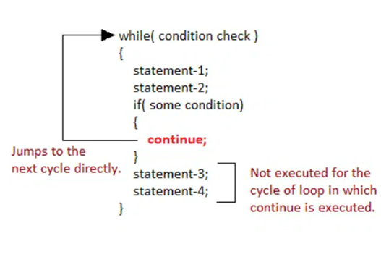
continue Statement
To execute the next iteration of the loop.
Syntax:
//loops stmts
continue;
//stmts to be skipped

Slide 6
Write a C program to continue for loop when for 5th iteration of loop statement.
//program on continue
#include<stdio.h>
int main(){
int i=1;//initializing a local variable
//starting a loop from 1 to 10
for(i=1;i<=10;i++){
if(i==5){//if value of i is equal to 5, it will continue for next iteration
continue;
}
printf("%d \n",i);
}//end of for loop
return 0;
}

Slide 7
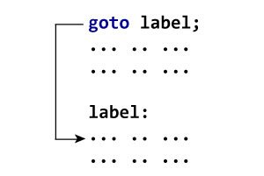
goto Statement
The goto statement allows us to transfer control of the program to the specified label.
Syntax:
label:
//some part of the code;
goto label;

Slide 8
goto Statement
Parts of goto statement
goto is divided in two parts, label definition and goto keyword.
Label
“Label” is a valid C identifier followed by colon symbol :
Label specifies control transfer location.
Each label work as a bookmark to specific location. You are free to define any number of labels anywhere inside a function.
goto:
“goto” is a keyword used along with label name to transfer program control to the mentioned label.
You can only transfer program control to a label within same function.

Slide 9
WAP to calculate the sum and average of positive numbers
// If the user enters a negative number, the sum and average are displayed.
#include <stdio.h>
int main() {
const int maxInput = 100;
int i;
double number, average, sum = 0.0;
for (i = 1; i <= maxInput; ++i) {
printf("%d. Enter a number: ", i);
scanf("%lf", &number);
/ go to jump if the user enters a negative number
if (number < 0.0) {
goto jump;
}
sum =sum+ number;
}
jump:
average = sum / (i - 1);
printf("Sum = %.2f\n", sum);
printf("Average = %.2f", average);
return 0;
}

